Slide 1
A QAPI TOOL FOR ASSESSING EQUITY AND DIVERSITY IN HOSPICE
PRESENTED BY:
TAMIRA CLARK, RN/BSN
DON, PASSAGES HOSPICE-NORTHEAST MONROE, LA
SANDY GRIFFIN, LPN/CHPLN/BSHA
COO/QA COORDINATOR, HOPE HEALTHCARE AND HOSPICE BC HOUMA, LA

Slide 2
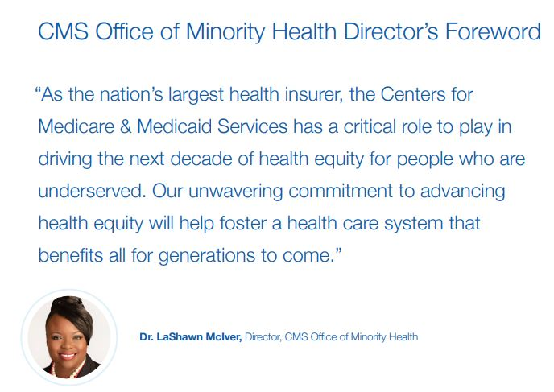

Slide 3
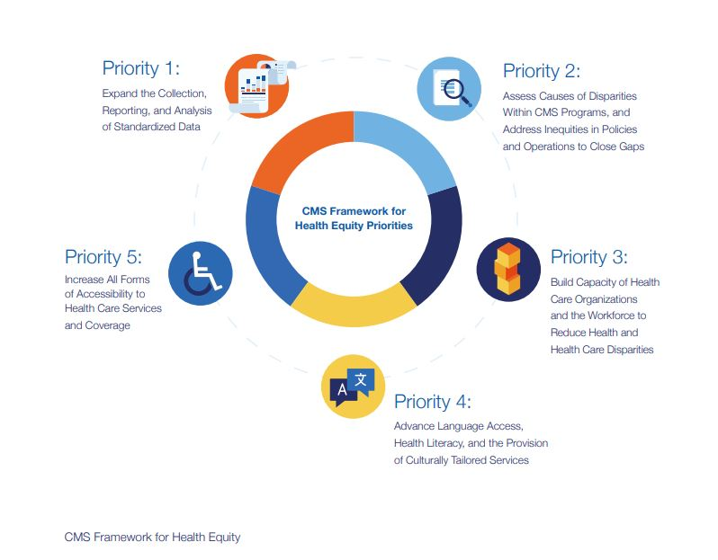

Slide 4
WHY WAS THE EQUITY PLAN CREATED?

Slide 5
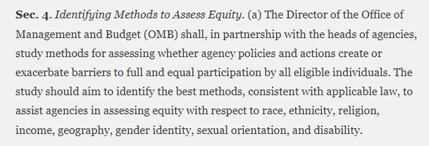
Executive Order 13985 of January 20, 2021: SECTION 4

Slide 6
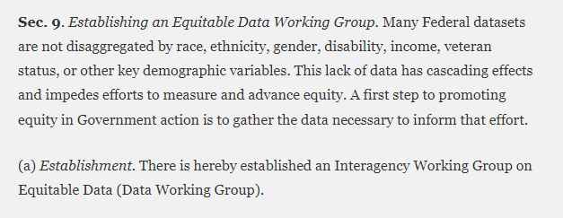
Executive Order 13985 of January 20, 2021: SECTION 9

Slide 7
HOW WILL CMS COLLECT EQUITY DATA?

Slide 8
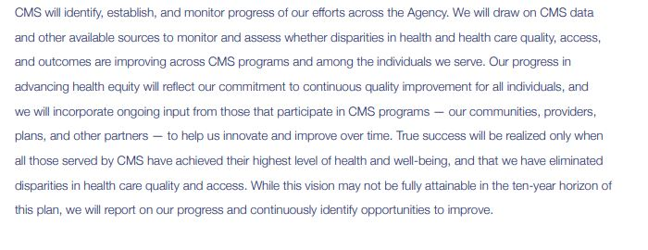

Slide 9
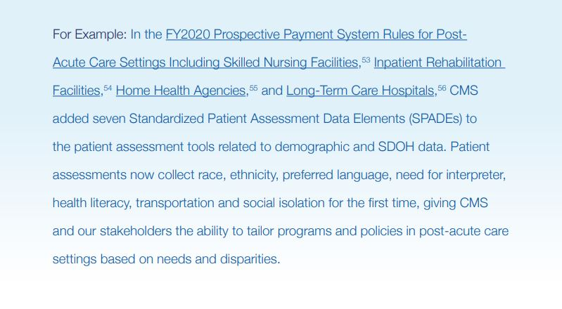

Slide 10
HEALTH EQUITY IS TIED INTO THE EMERGING VALUE BASED INSURANCE DESIGN
Medicare Advantage Hospice Carve-In
First Introduced in 2021
Voluntary Program-ENROLLMENT HAS DOULBED SINCE 2021
GIVES BENEFICIARIES INCENTIVES TO CHOOSE IN NETWORK PROVIDERS
Health Equity Incubation Program
Participating MAOs will prepare health equity plans detailing how they will address disparities and outcomes
Designed to identify and implement best practices for health equity and building and evidence base for quality improvement

Slide 11
USING Z CODES TO REPORT/ANALYZE SDOH
(SOCIAL DETERMINENTS OF HEALTH)

Slide 12
EXAMPLES OF SDOH Z CODES

Slide 13
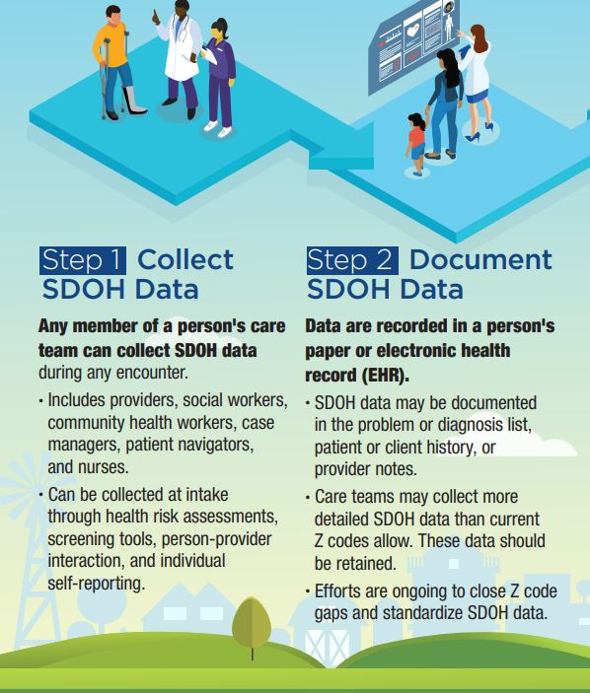
USING Z CODES TO REPORT SDOH DATA
(SOCIAL DETERMINENTS OF HEALTH)

Slide 14
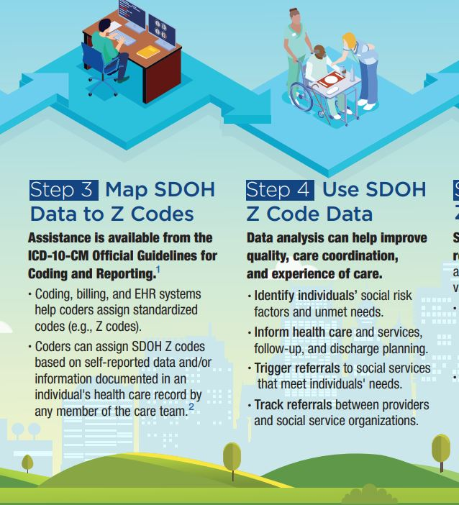

Slide 15
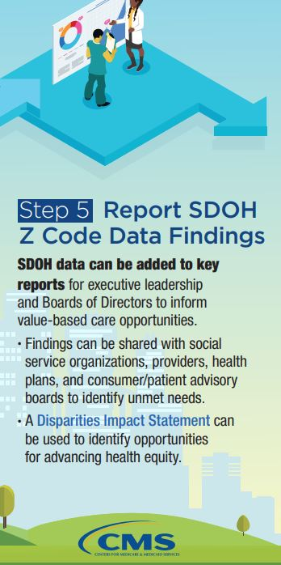

Slide 16
HOW DOES THE RACIAL MAKEUP OF YOUR PATIENT POPULATION COMPARE TO THE COMMUNITY YOU SERVE?

Slide 17
Patient Diversity Assessment
Using the Patient Diversity assessment Tool to assess your agency.
The first step is to gather data on your population of patients served in your agency for the last 12 months. You need to be able to separate this data by race. Most EMR’s should have a report for this. Admissions with demographic data should get the data needed in most cases.

Slide 18
Patient Diversity Assessment
After gathering 12 months of data, it should be filtered by race, and totals for admits in each category of race noted.
Next, take the total number of patients your agency admitted in that same 12-month period and divide it into the number of patients admitted for each race.
This will give you the percentage by race you admitted in each category.

Slide 19
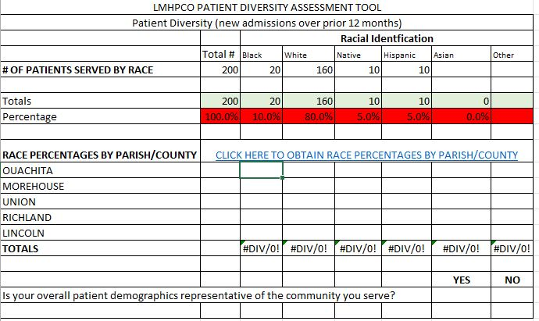

Slide 20
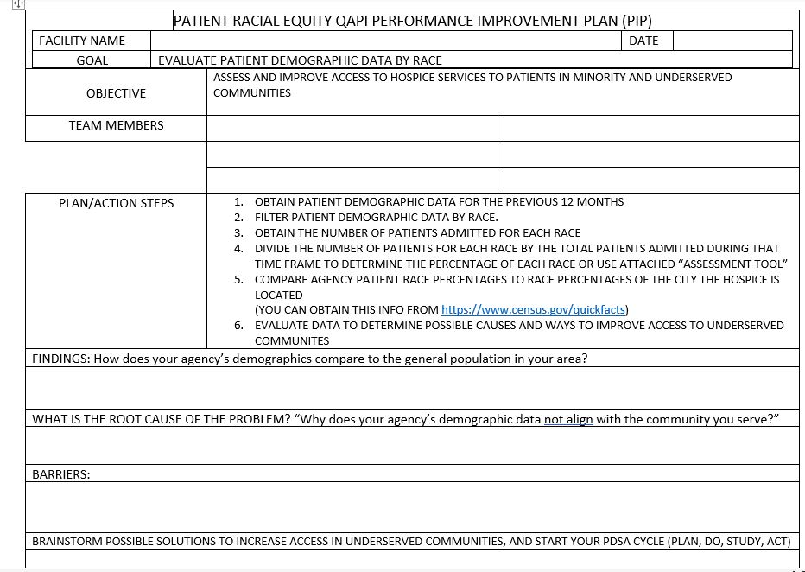

Slide 21
Patient Diversity Assessment
Navigate to the website: U.S. Census Bureau QuickFacts: United States
1
Find your agency’s city
2
Compare the population by race percentages by area to the admissions by race percentages for your agency
3
Percentages can be compared by the city your agency is in, or adapted to the areas your agency serves, or the areas covered in the 12 months of data.
4

Slide 22
HOW TO USE THE STAFFING EQUITY/DIVERSITY QAPI TOOL

Slide 23
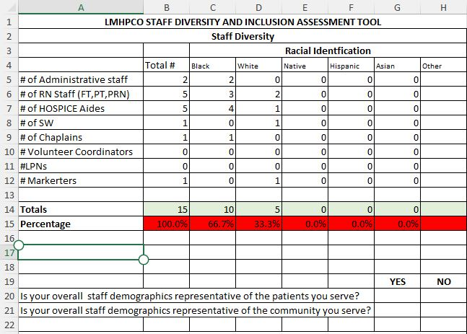

Slide 24
BARRIERS TO STAFFING DIVERSITY
PERSONAL FEELINGS OF EMPLOYEES REGARDING RACE
RACIAL MAKEUP OF LEADERSHIP
WHERE ARE YOU ADVERTISING FOR POSITIONS?

Slide 25
SOLUTIONS
CONTACT HBCUS IN YOUR AREA TO HOST CLINICAL STUDENTS
ENSURE THAT THE WORK ENVIRONMENT IS INCLUSIVE
UTILIZE ALTERNATE JOB POSTING SITES
SOCIAL MEDIA-USE TO SHOW THAT YOUR AGENCY IS DIVERSE

Slide 26
Benefits of Improving Service in Underserved Communities
Ensure access to high quality care
1
Build relationships
2
Increase base of patients
3

Slide 27
Barriers to Providing Services
Languages
Religion
Possible change from traditional POC
Non-diverse staff

Slide 28
Solutions to Barriers
Build relationships
1
Provide education outside of familiar networks
2
Partner with faith-based organizations
3
Reach out to racial advocacy group leaders
4

Slide 29
REFERENCES
Greenwood, N., Habibi, R., Smith, R., & Manthorpe, J. (2014). Barriers to access and minority ethnic carers’ satisfaction with social care services in the community: a systematic review of qualitative and quantitative literature. Health & Social Care in the Community, 23(1), 64–78. https://doi.org/10.1111/hsc.12116
Vossel, H. (2021, September 2). Value-Based care may open doors to hospice among underserved. Hospice News. https://hospicenews.com/2021/09/02/value-based-care-may-open-doors-to-hospice-among-underserved/
Executive Order 13985 of January 20, 2021:
https://www.federalregister.gov/documents/2021/01/25/2021-01753/advancing-racial-equity-and-support-for-underserved-communities-through-the-federal-government
CMS Framework for Health Equity:
https://www.cms.gov/files/document/cms-framework-health-equity.pdf
RACIAL DIVERSITY/SALARY QAPI CAN BE DOWNLOADED FROM LMHPCO WEBSITE: HEALTH DISPARITIES AND INEQUITIES TASK FORCE
https://www.lmhpco.org/index.php?option=com_content&view=article&id=89:health-disparities&catid=20:site-content&Itemid=175 –
Copy of LMHPCO STAFFING-PATIENT DIVERSITY QAPI.xls (live.com)
Hospice VBID: Understanding the 2023 Program Modifications - Hospice News

Slide 30
Questions?
Thank you for your participation in this webinar

